Slide 1
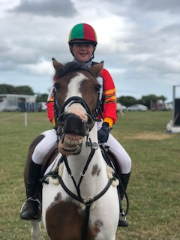
Carlow Hunt Pony Club
Annual Parents Meeting
13th November 2018
Doyles, Bagenalstown, Co Carlow

Slide 2
District Commissioner Report for 2018
DC’s: Mr. Ivan Hatton & Mr. David Burgess
Secretary/ Assistant D/C – Ms. Eliz Malone
Treasurer: Pat Bevan

Slide 3
U10 Rallies/Novice and General rallies
Under 10 Rallies – very important mechanism for bringing young members along, improving their confidence and riding skills in a smaller setting, excellent for instilling confidence and preparing members for larger rallies and camp.
Total number held in 2018 was 9
General rallies – reflect the health of the club- 3 held, (reduced number on account of weather and ground conditions, with a full calendar of events already planned it was not possible to fit in more)
Thanks to all the land owners for allowing the club to use their facilities.

Slide 4
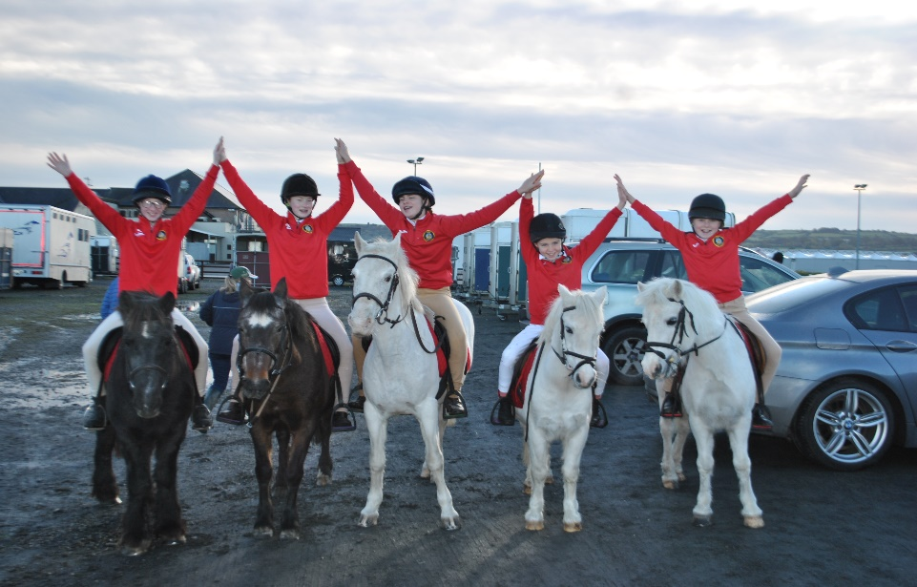
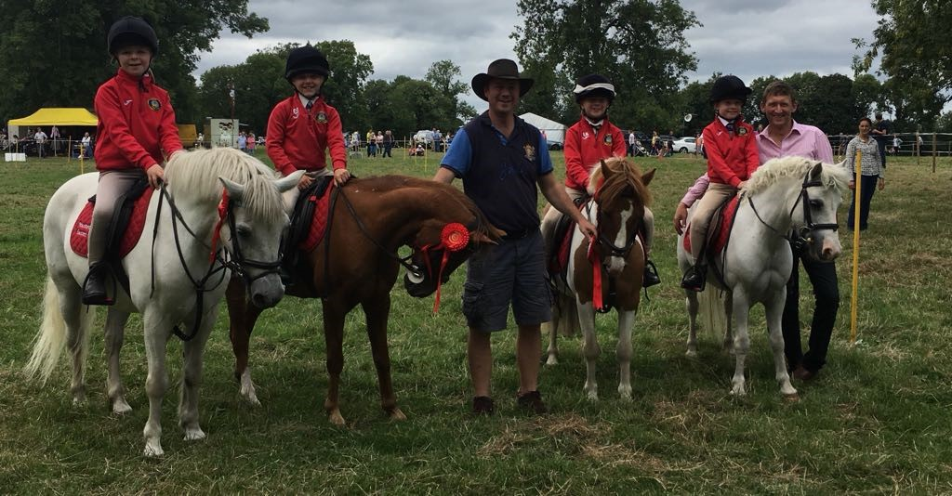
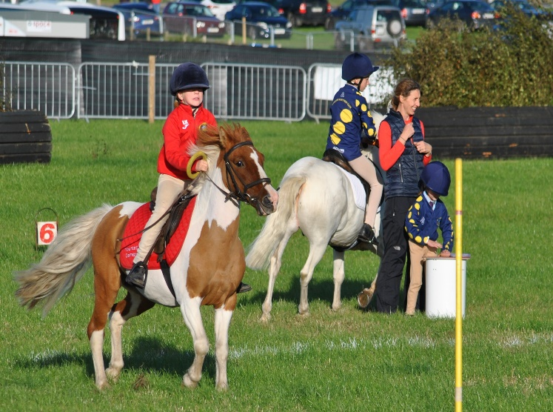
Mounted Games

Slide 5
Mounted Games
The games children started their training sessions in Donohues and then moved to their new home in Fenagh, thanks to Sandra and Jimmy. Training commenced in April and continued every Friday evening up to September.
Interest in games continued to grow this year with excellent turn outs every week.
Games competitions attended:
South East League – 4 league games with final in Waterford, at the County Fair in Portlaw
Shows- Stradbally, Carnew, Tinahealy, Tullow and National Ploughing Championships culminating in Punchestown at the international mounted games competition held in Punchestown.

Slide 6
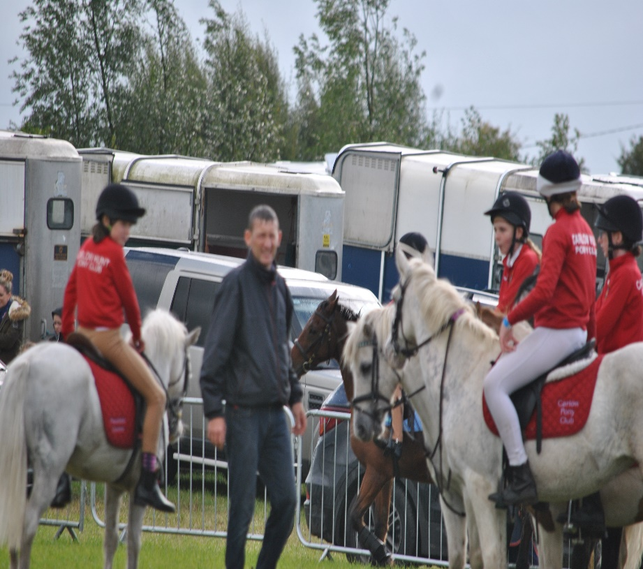
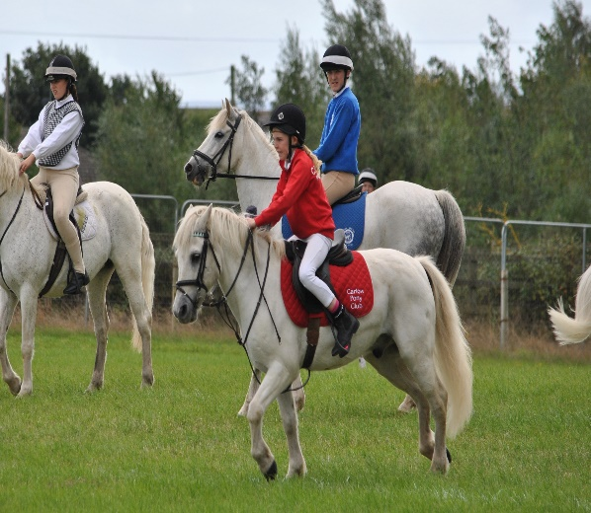
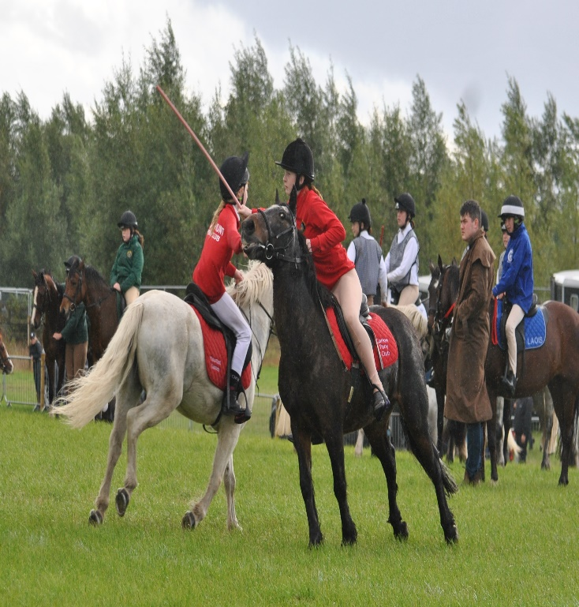
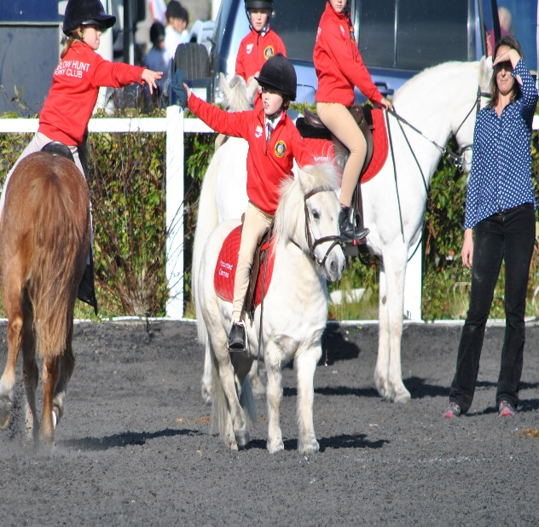

Slide 7
Minimus Family 2018 Punchestown

Slide 8
The winning teamof David Farrell, Ava Murphy, Ruth Fogarty and Sarah Kehoe

Slide 9
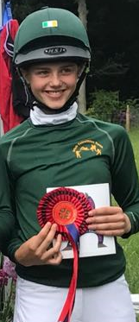
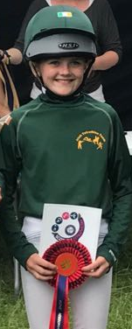
International Minimus Competitors
Sarah Kehoe On winning Irish girls team in Kelso, also individually placed 1st
Ruth Fogarty On winning Irish girls team in Kelso, UK, also individually placed 2nd

Slide 10
Just chilling

Slide 11
Down to the serious business

Slide 12
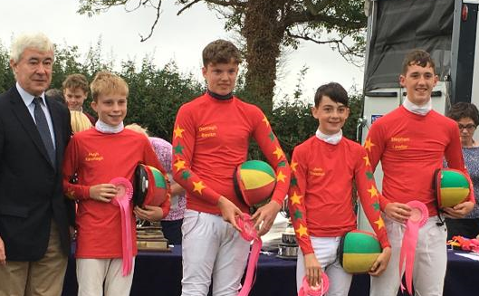
Boys Junior team of Hugh Kavanagh, Daragh Bevan, Jude Donohue and Stephen Lawlor
Hannah Kehoe receiving 1st prize for fastest run in Crecora, and for finishing 2nd over all.

Slide 13
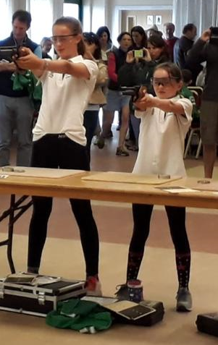
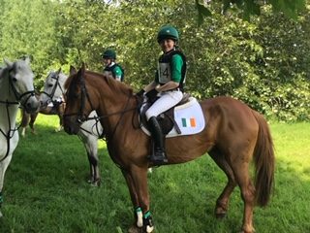
Representing Ireland in UK
Ruth and Sarah taking part in the shooting element of Junior Tetrathalon in UK championships
Hannah with her Irish team mates in background waiting to set off on Cross country course. Team finished 2nd overall

Slide 14
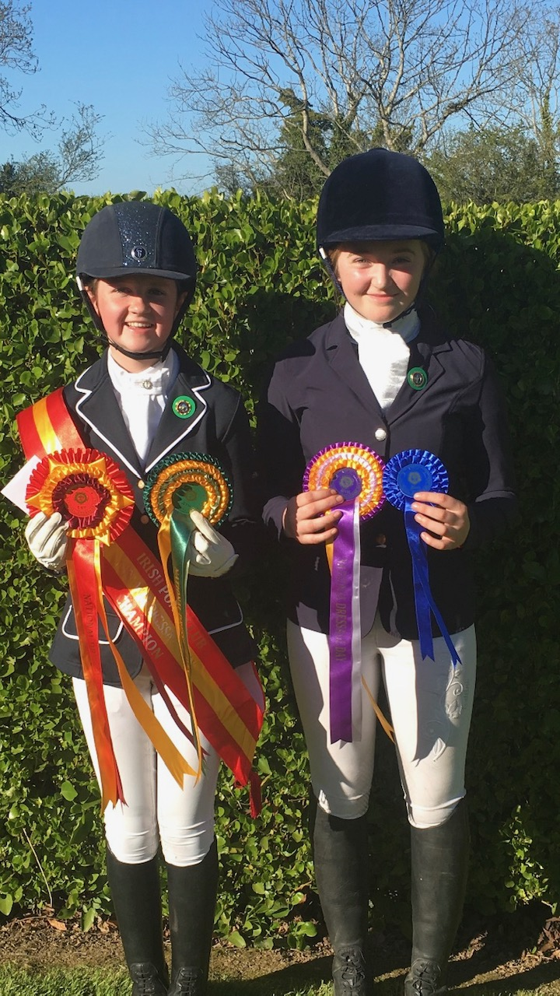
National Dressage Day
National Dressage Day- 24th June Spruce Lodge
Megan T Kelly 4th Open
Holly Malone 6th Intermediate
Rachel Carr 1st and 4th
Ellen Kelly also represented the club.
Notes:
D training

Slide 15
Combined Training & Pure Dressage
Combined training –Area Qualifier 10th July, Boswell
10 members travelled, the club was very well represented in all categories.
Results: 4 x 1st places Phenomenal result
Open - Ailish Osbourne 1st
Intermediate - Holly Malone 1^{st,} Jack Carr placed 4th
Junior - Rachel Carr 1st
Under 12 - Eliza Kavanagh 1st
Under 10 - Ellie Kavanagh 3rd

Slide 16
Áilish, Ellen, Rachel, Holly, Jack

Slide 17
Combined training U10 & U12
Ellie Kavanagh
Eliza Kavanagh

Slide 18
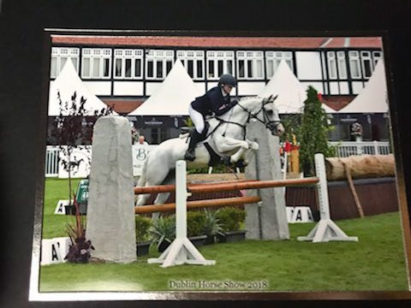
Dublin Horse Show 2018
Holly Malone competed in Combined Training competition and placed 6th
Áilish Osbourne competed at open level of CT, retired following dressage due to injury.
Holly and her pony Fionn

Slide 19
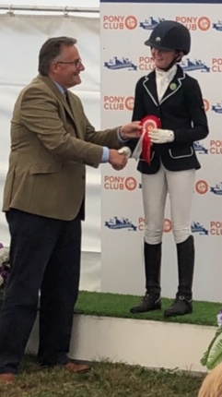
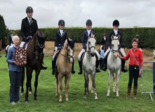
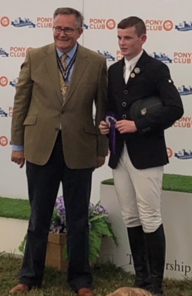
Rachel Carr receiving her rosette for being placed in the Top 10 individually in UK Championships.
Jack Carr receiving his rosette for being placed 6th in his arena in Open Competition at UK Championships
Pure Dressage team being presented with Bill Fisk Trophy by Ms. Barbara Micks and Kate Harvey at Irish Championships

Slide 20
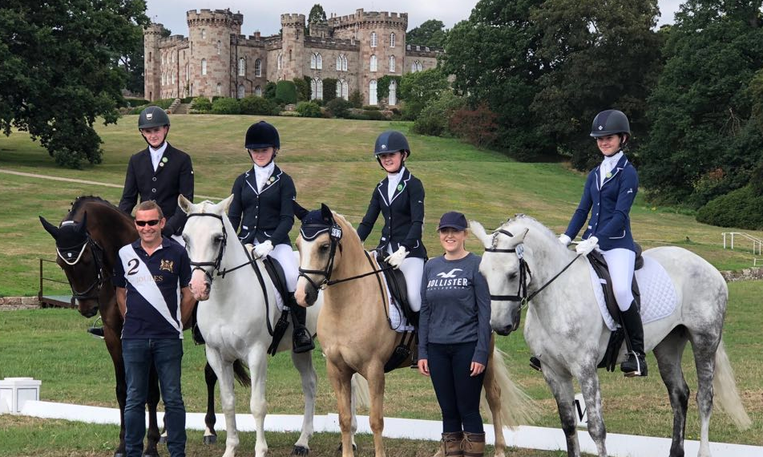
Carlow Team who travelled to UK Pony Club Championships
Pure dressage:
Team of Jack Carr, Holly Malone, Rachel Carr, & Ellen Kelly Who competed at UK National Championships at Cholmondeley Castle in Chester
Very successful weekend for the club

Slide 21
Show jumping
Spring league with competition on Coole and Coil Og.
3 Qualifiers for the festival
Area qualifier in Barnadown, sponsored by Morrins of Baltinglass
Alice Mernagh x2 teams, Robbie Bailey x8 teams
John Ledingham x 8 members, Open Individual x 1
AM – placed 3rd
RB- 1st and 5th
JL 1st and 2nd
Festival: Show- jumping
All teams competed very well, unlucky on the day as just out of the ribbons, however horsemanship skills were noticed and prizes given for same.

Slide 22
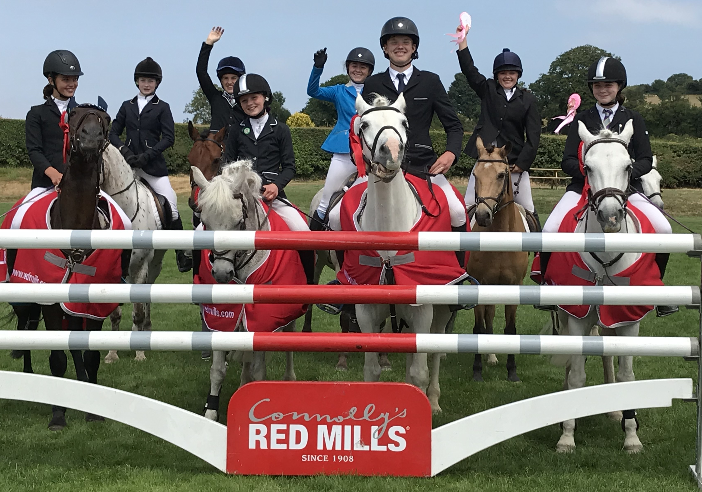
Robbie Bailey Teams <
Alice Mernagh Teams >

Slide 23
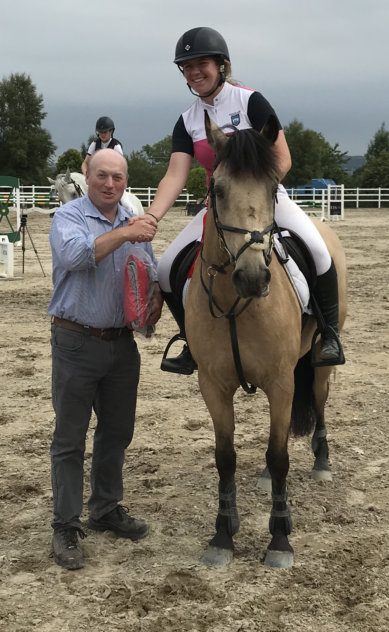
Area Qualifier in Barnadown, July 11th
Lucy Bolger Open Individual
Catherine Kavanagh Intermediate Individual

Slide 24
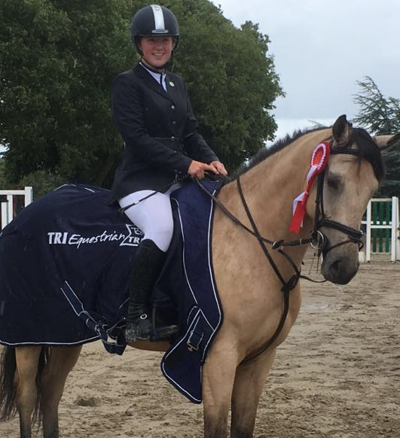
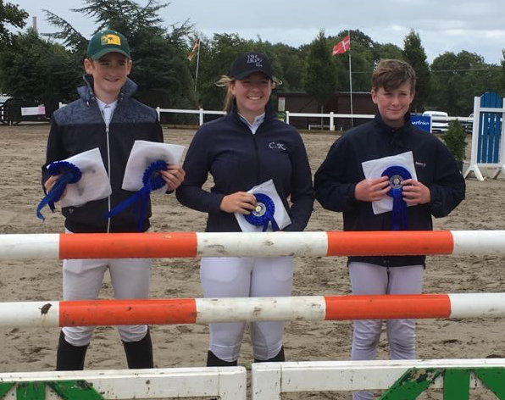
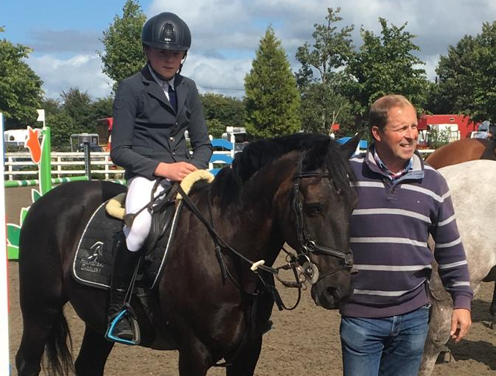
Festival Show Jumping
Aoife Murphy 5th place Intermediate Individual Class
Catherine Kavanagh 1st place Inter. Individual Class
Matthew Farrell 4th place in 1m class
Patrick Doyle, Catherine Kavanagh & Alex Redmond Prize for Horsemanship at Intermediate level

Slide 25
Camp 2018
Venue: Curracruit, Bagenalstown courtesy of the Fenelon family.
2nd July -6th July
Participants – 100
14 instructors
50+ awards/rosettes and presentations given out
Great week, Thanks to Farmers Hunt for sponsoring the BBQ meats and James and Suzanne Bolger for other condiments on the day. Thanks to Schone family for providing ice-creams to all present.
Instructors Tent kindly provided by Donohue Marquees.

Slide 26
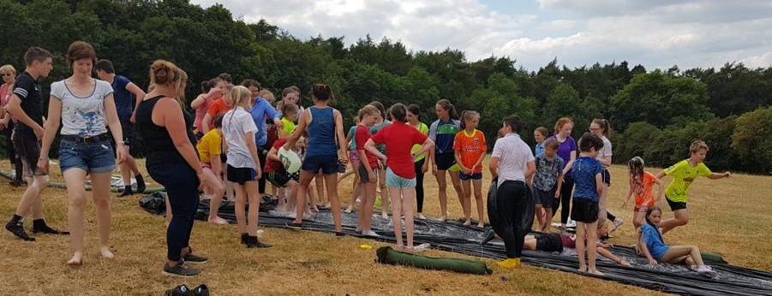
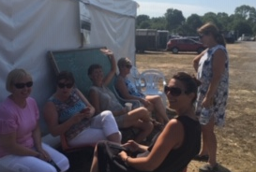
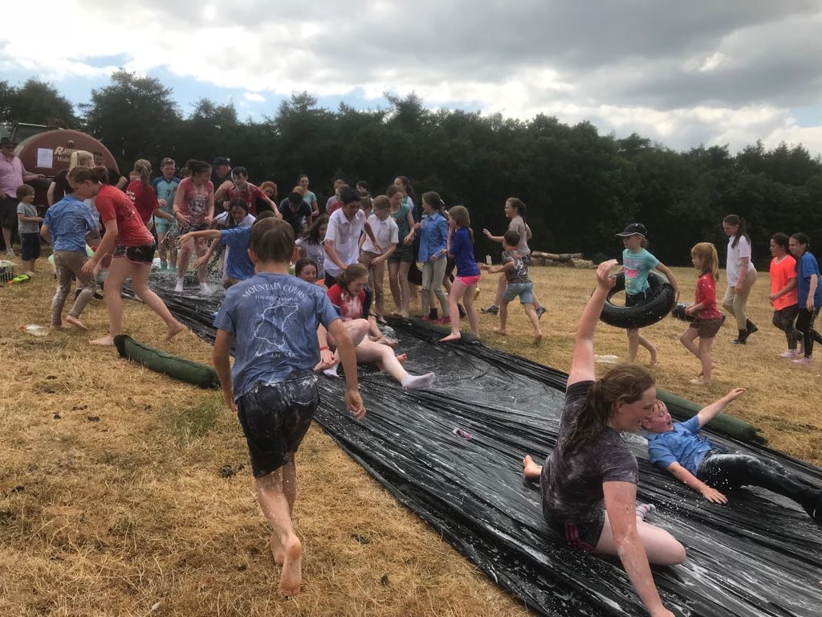
Having fun
Not a pony in sight

Slide 27
ODE Qualifier Redmills
10th June 2018
Venue: by kind permission of Norton family, Newtownbarry House
Entries – 215 competitors
Launch of new championship arena introduced
The club was congratulated on the quality and standard of the course, compliments on the day and emails came from parents who attended
Very well supported by our members competing themselves
Results-
Intermediate – Jack Carr 5th, Holly Malone 6th,
Junior – Rachel Carr 3rd
U12-Championship - Caoilfhionn Lawlor 6th , Martha Dolan 5th
U12 – Non Championship – Jodie May 2nd, Lilly Redmond 4th

Slide 28
Members Ava Murphy and Bella Donohue showing off the new cup for the Under 12 Championship Competition

Slide 29
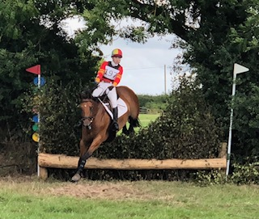
Eventing Championships Ballindenisk Cork
Avril Kelly heading for home
Jude Donohue presented with prize for 2nd place by Dr Marena Brennan, Chairperson for Eventing

Slide 30
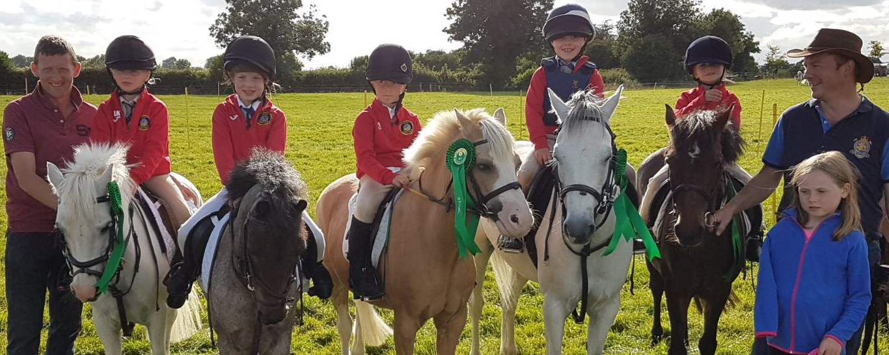
Pony Club Festival:
Club participated in disciplines,
Games,
Show Jumping,
Combined Training,
Pure Dressage.

Slide 31
Beach ride & Auction in aid of Crumlin Children’s Hospital and CHPC
Serious business from Laurel and Hardy as hammer fell

Slide 32
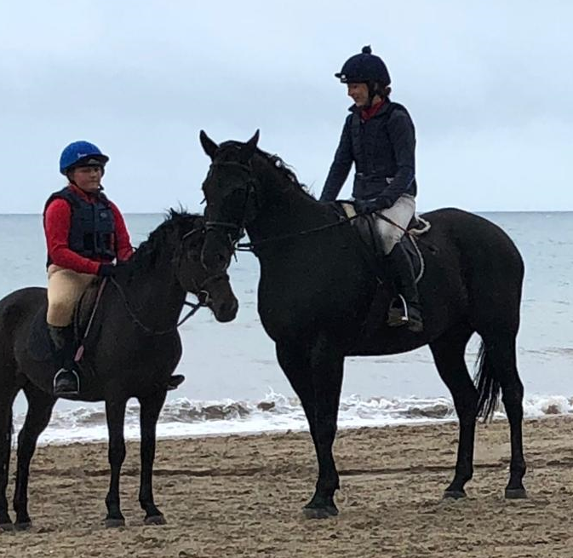
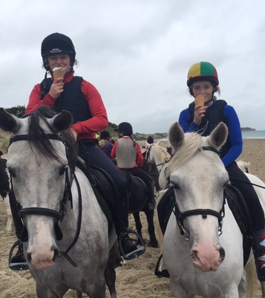

Slide 33
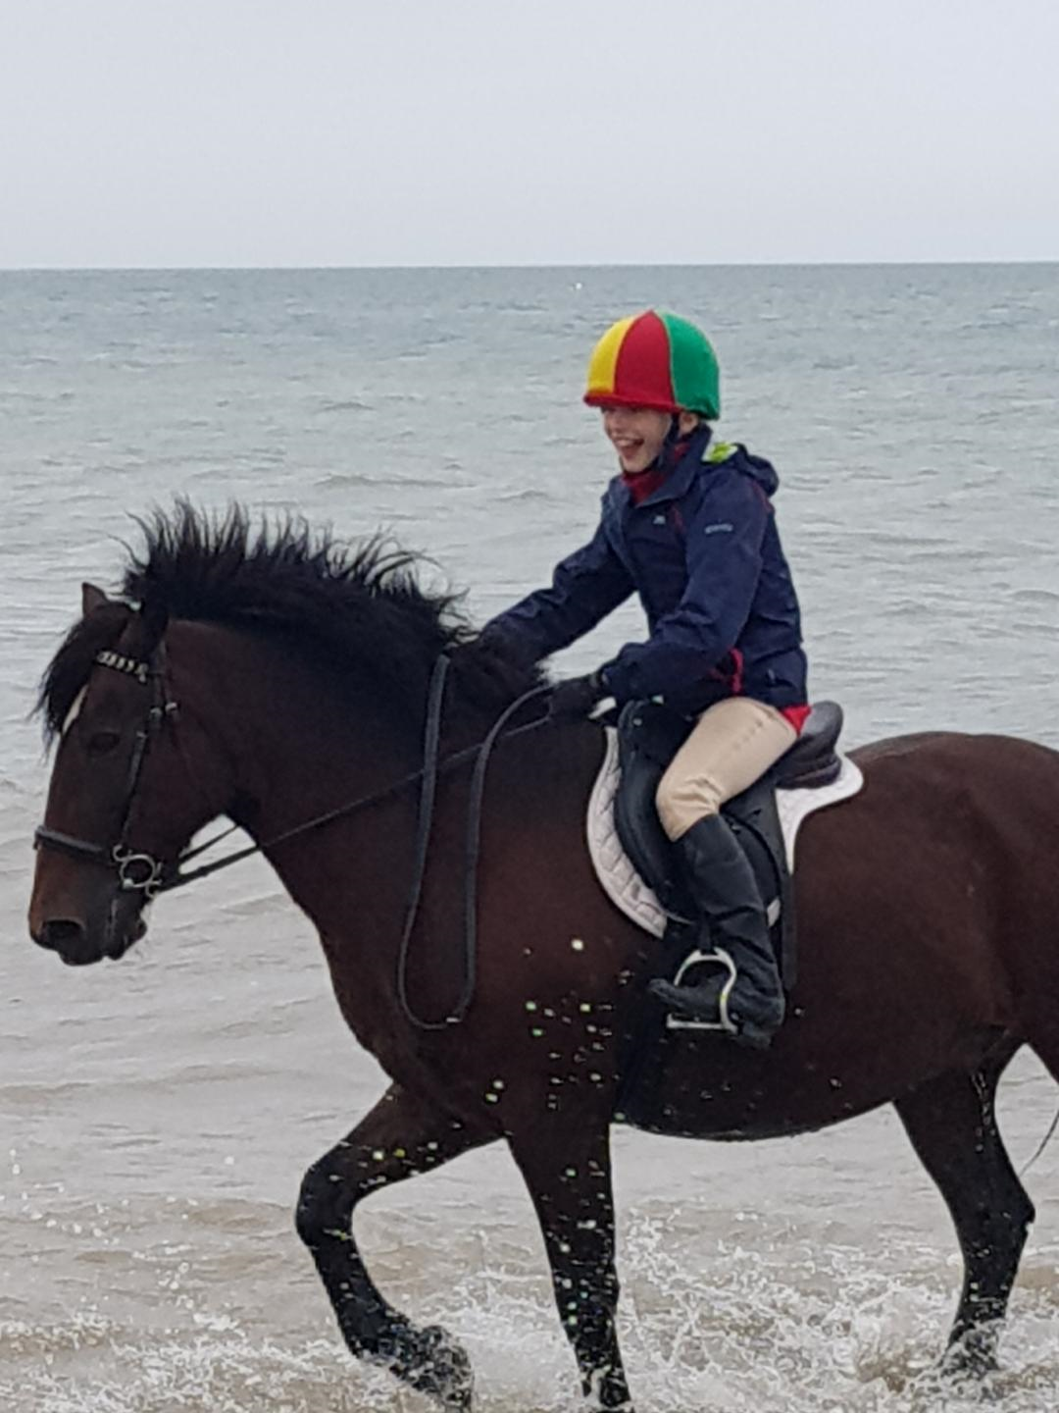
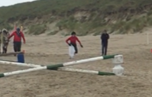
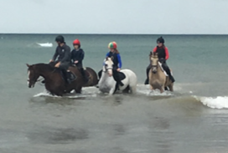

Slide 34
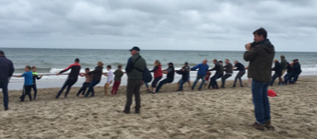
All the girls on the left V All the boys on the right

Slide 35
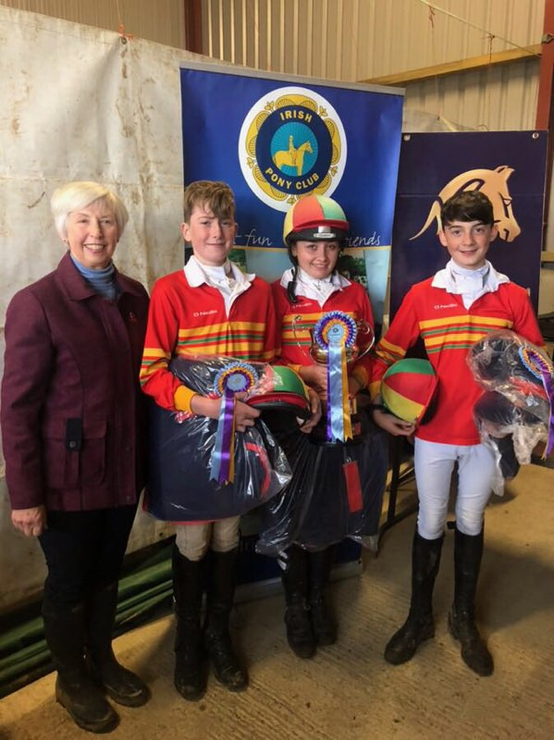
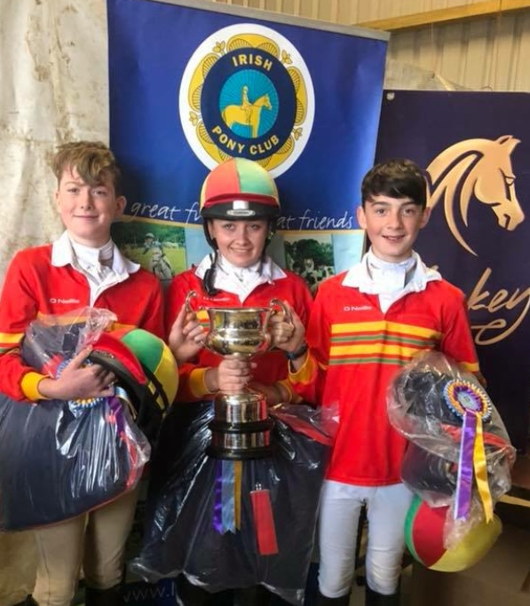
Hunter Trial Championship
New venue in Moorefield kennels, New Ross, Co Wexford 22nd September 2018
31 entries from the club, (20 in 2017)
Junior singles- Isabella Donohue 6th Place
Novice Intermediate- Megan Flood 5th Place
Senior Individual Alec 4th Place
Team of 3 Alec Redmond, Lorna Byrne and Jude Donohue 1st Place,
Barbara Micks Chairperson of IPC, with our team of 3, Alec Redmond, Lorna Byrne and Jude Donohue holding the trophy.

Slide 36
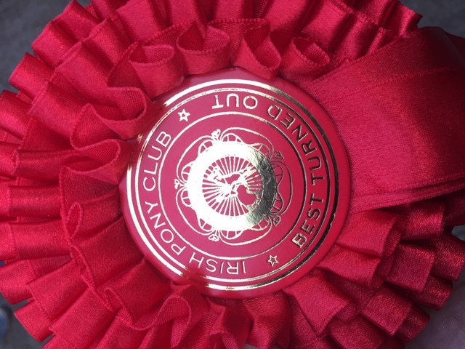
Darragh Bevan, Holly Malone and Amy Mc Donald, best turned out of team of 3 competitors

Slide 37
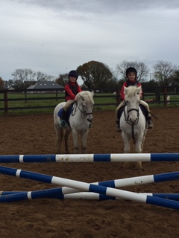
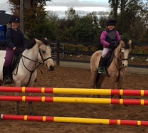
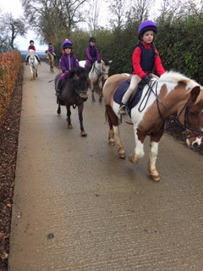
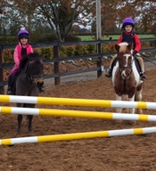
Mini Camp with Debbie

Slide 38
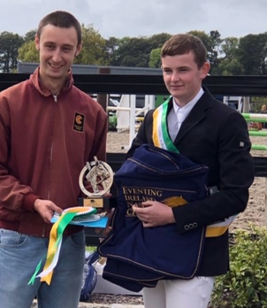
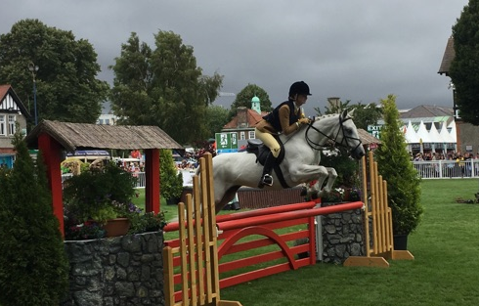
Achievements outside Pony Club Club
Jack Carr won EI 100 National Title at Eventing Ireland Championship in September
Ellen Kelly with Quantum Competing in Working Hunter class at RDS Horse show

Slide 39
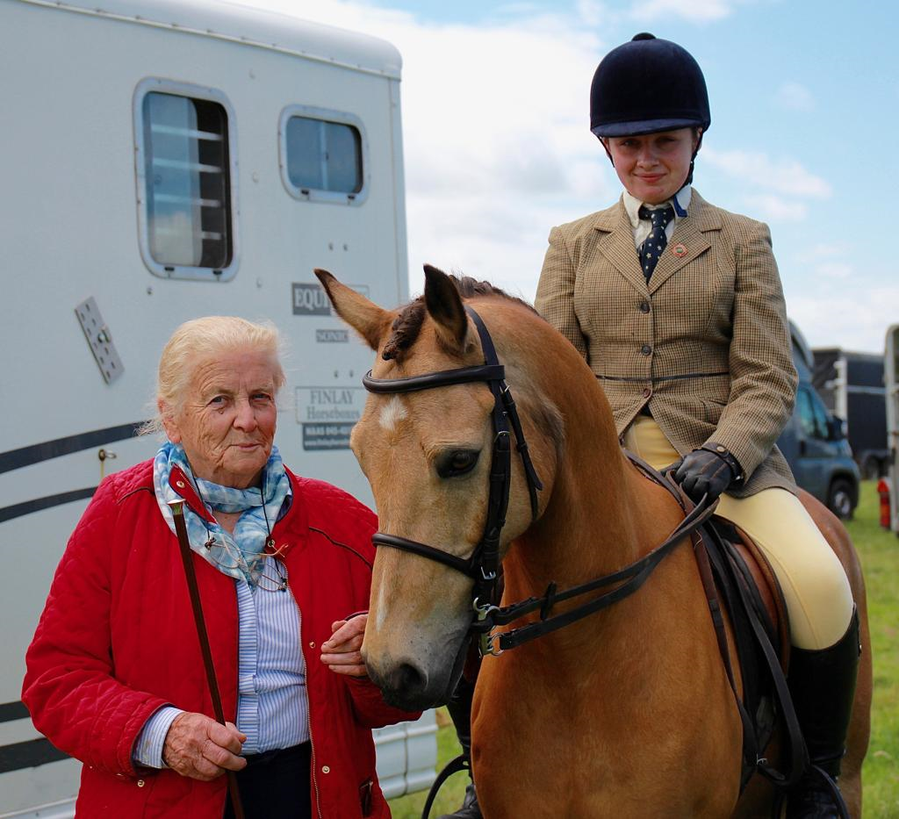
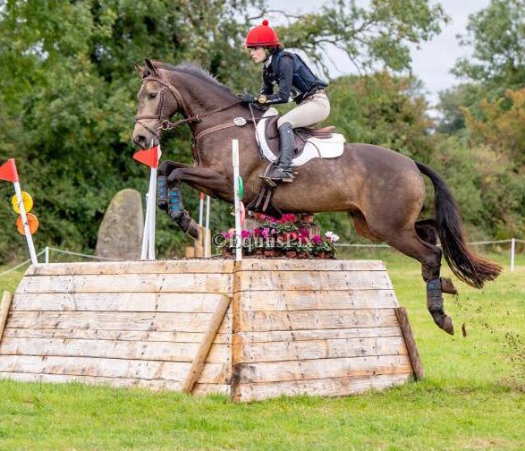
Megan Telford Kelly riding Mr. Chocolate at Ballindenisk, International CCI2*
Lorna Byrne with her grandmother Eileen Brennan before Showing Class

Slide 40
Special Thanks
The club has proudly shared in many, many great moments with its members and their families, we congratulate you all, the hard work, dedication and incredible team spirit that gave Carlow Hunt Pony Club a great year:
CHPC were also placed 2nd in the Lillingston Cup award in 2017, awaiting results for 2018
We would like to thank the many landowners who have facilitated our members over the past 12 months:
Thanks to you the Parents and the Committee of 2018 who have been so helpful to us and making the year so enjoyable:
And finally the most important thank you goes to our members your children.

